Slide 1


Slide 2

E-Sports & Gaming Analytics
AIS 2021 Analytics Challenge
Kevin Gonzalez Garcia
Pablo Valle
Andres Arias
Notes:
Good day!
We are the Mean Team with a (k) and
Our team is comprised by [First Kevin], [Pablo Valle] and [Andres Arias]

Slide 3




Gaming 101
The framework to comprehend the industry
Gaming
Today
Gaming by the numbers
Popularity
The makeup of a popular game
Growth
How games grow in audience
Notes:
Today we will go through four sections reviewing:
1. the basic makeup of Gaming Industry,
2. Some of the descriptive insights we’ve found,
3. We will look into the makeup of popular games
4. and finally review how games grow.

Slide 4
Gaming 101
The framework to comprehend the industry
Gaming
Today
Gaming by the numbers
Popularity
The makeup of a popular game
Growth
How games grow in audience
Notes:
“Kevin will now give us a brief introduction
to the gaming industry, Kevin take it away”

Slide 5




Games are like movies
DIGITAL
Both have gone through a digital transformation (VHS>DVD>Digital>Streaming | Cartridge > DVD > Digital>Streaming)
NEW BUSINESS MODELS
One-time transaction, Free to Play (ad supported), Merchandising, Game extensions, in-app/game purchases (e-commerce), subscriptions (all-you-can-play), revenue share with platforms.
PERFORMANCE UNCERTAINTY
No Historical data to forecast demand for a new title. Hard to decide marketing / development budgets.
HIGH DEV / MARKETING COSTS
Largest line items and operating headcount.
Analytics have become increasingly critical for game design/improvement, attribution marketing, etc

Slide 6


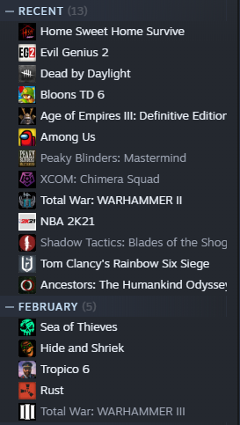
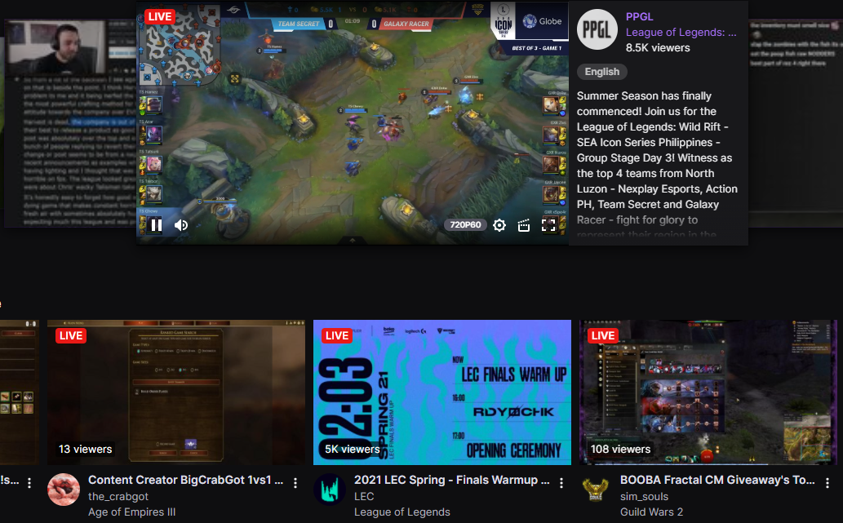



Video Games run on digital platforms
A video game digital distribution service that allows players to purchase and play PC games through their software client.
Largest online streaming platform, primarily focused on video game live streaming and eSports broadcasting.
eSports
Form of competition using video games, often takes form of organized multiplayer competitions between professionals

Slide 7
Gaming 101
The framework to comprehend the industry
Gaming
Today
Gaming by the numbers
Popularity
The makeup of a popular game
Growth
How games grow in audience
Notes:
Objective: Introduce the next speaker… “Next, XXX will give us a view of the industry based on Key Performance Indicators, XXX?”

Slide 8
Gaming continues to evolve
Insights and Dashboards
Methods and Tools
Accessibility
Data file included data scraped from Steam (a game streaming platform) and sourced from Kaggle
The eSports data was the top 1,000 earning eSports players, a history of all eSports tournaments and their winnings
For the demographic data esportsearnings.com provided player profiles with descriptors like country and age
There was also the acquisition of Twitch viewership history sourced from Kaggle
For this part we modeled a lot of descriptive elements into a few dashboards enabling us to focus on a few key statistics
Gaming data itself is tied to demographic and geographic location thus it’s not extremely attainable so the insights are often shielded behind a paywall.
Gaming being a business deems api access threatening to companies (SBMM) leading to data being restricted to just tabular information.
Descriptive Questions
How have gaming trends changed over time?
How has COVID-19 affected the gaming industry?
Are there demographic or geographic patterns?

Slide 9
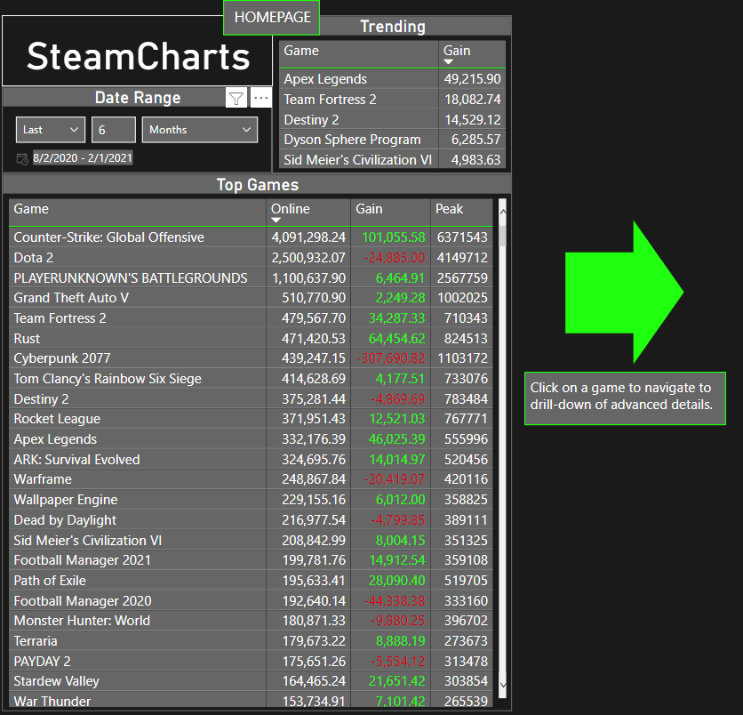
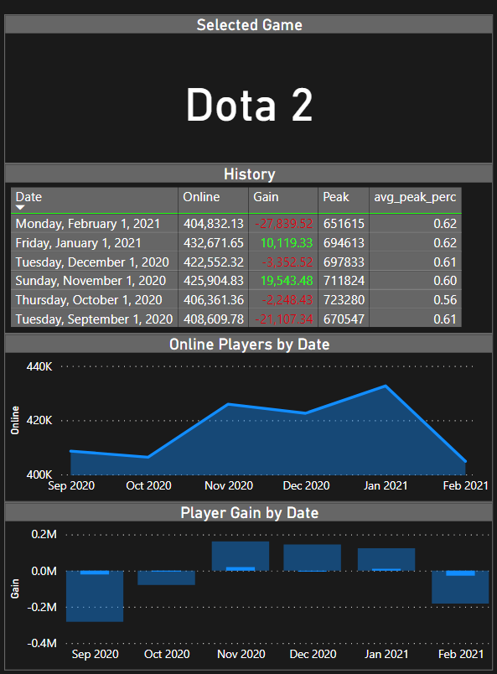
What’s Available
Steamcharts:
Exist
Summary
Spreadsheet esque
We aim to append data from different sources to better visualize the scape

Slide 10
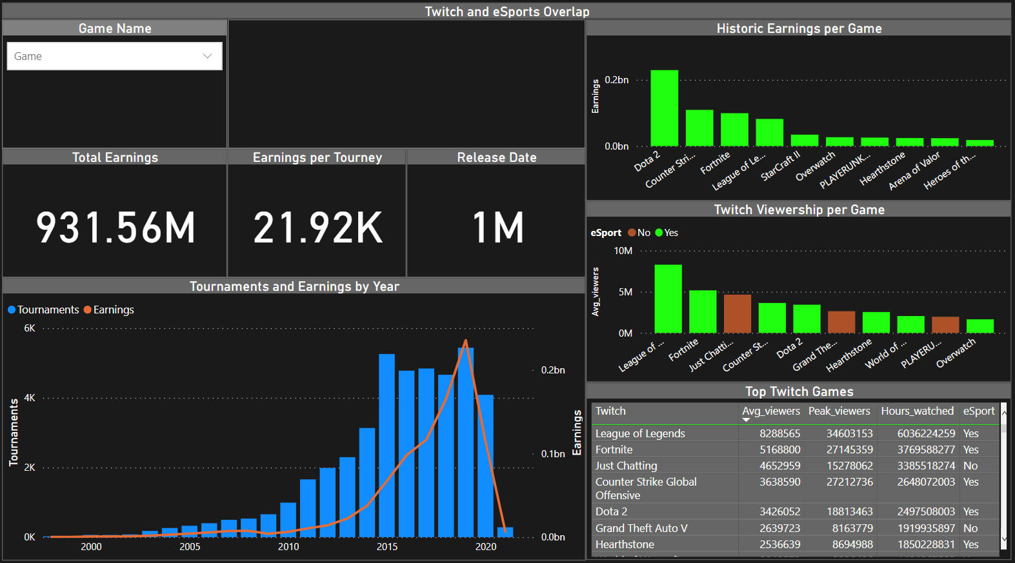
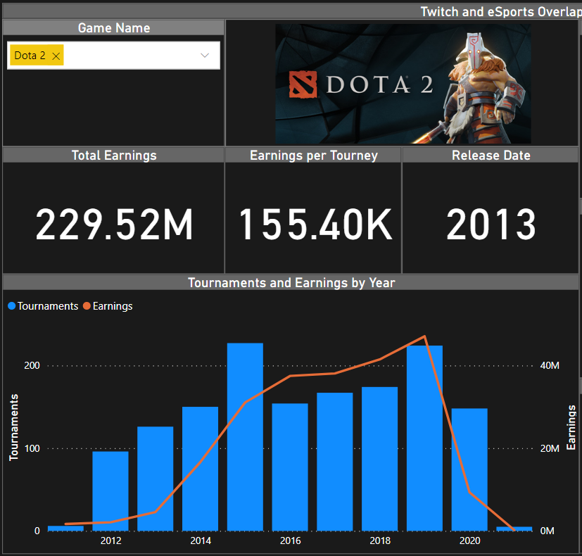
Twitch and eSports Overlap
The money is there
931 million in earnings since 2000
22k average earnings per tournament
Huge growth in recent years
10x growth in earnings this decade
Professional play saw Covid impact
Esports and Twitch Overlap
8/10 Top viewed Twitch games are eSports
Top Esports and Twitch games are multiplayer

Slide 11
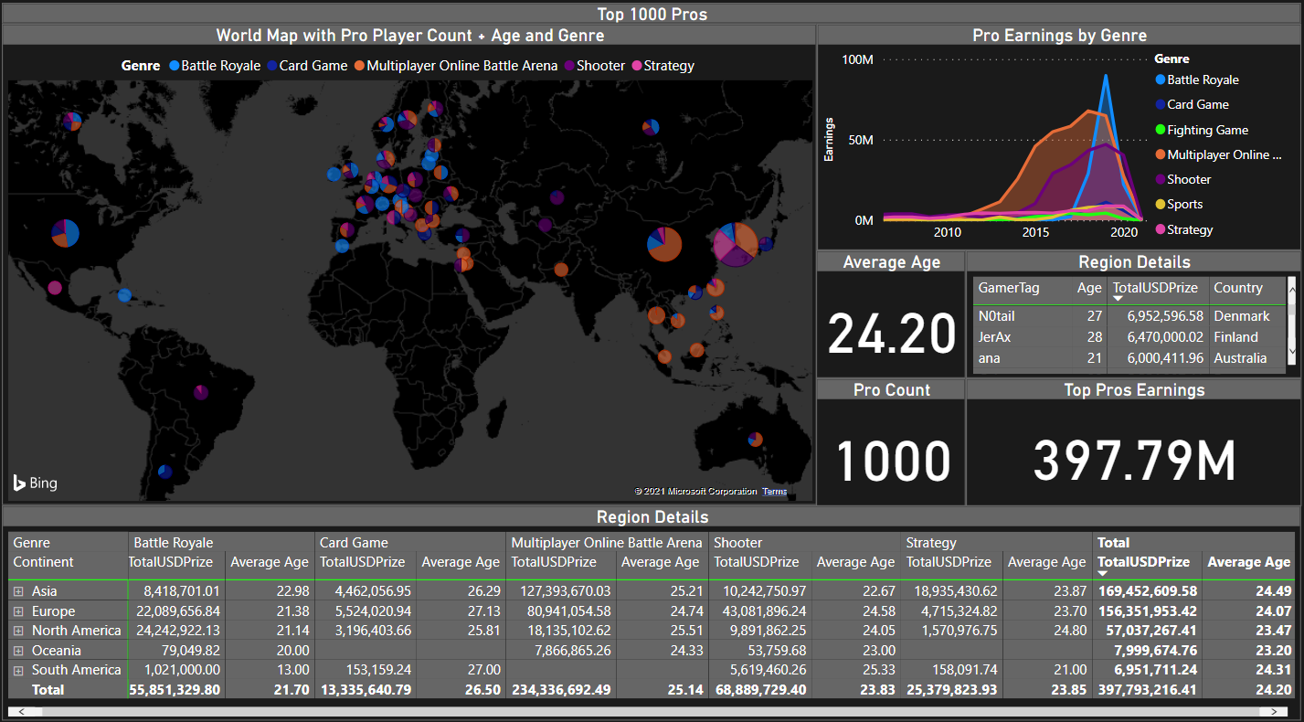
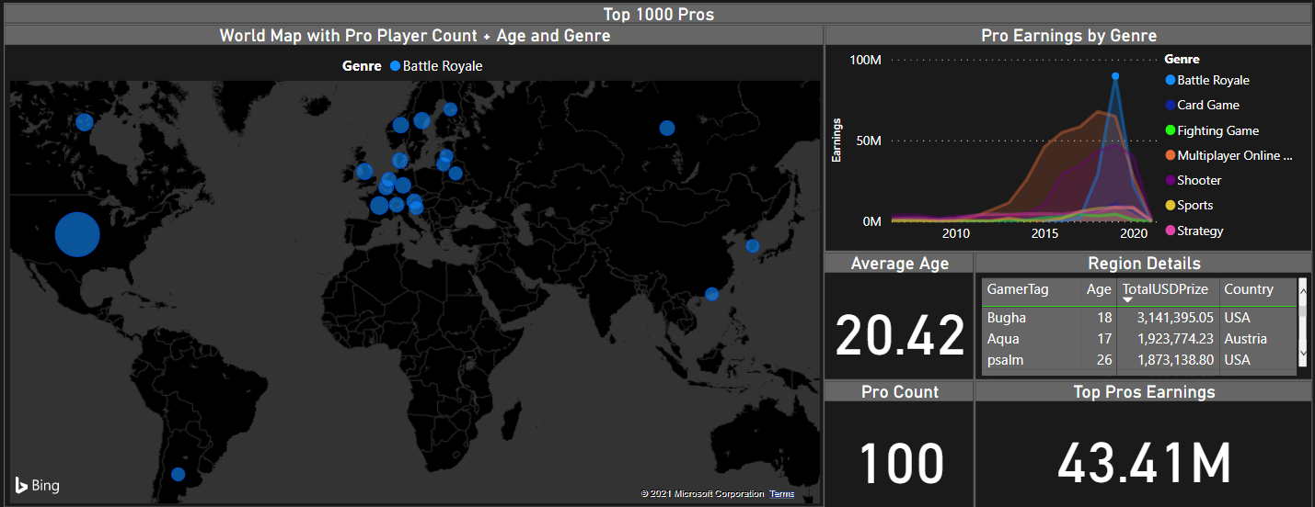
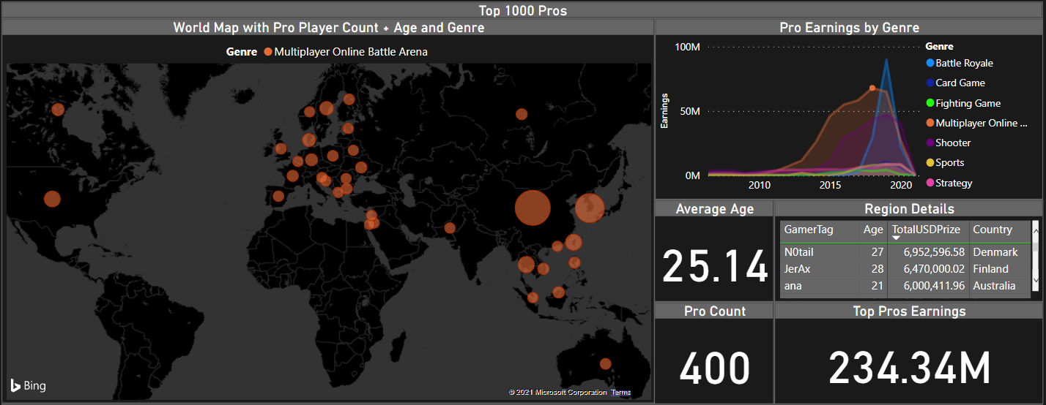
Top 1000 Pros Demographic
Gamers are young
Average gamer is 34
Average pro is 24.2
Youngest pro is 13
Huge growth in recent years
10x growth in earnings this decade
Professional play saw Covid impact
Gaming is borderless
In 5/7 Continents
Regions have varied gaming interest
South Korea, USA and China produce the most pros

Slide 12
Gaming 101
The framework to comprehend the industry
Gaming
Today
Gaming by the numbers
Popularity
The makeup of a popular game
Growth
How games grow in audience
Notes:
Objective: Introduce the next speaker… “Now that we now what is the gaming industry and the magnitude of both its engagement and revenue size, XXX will walk you through what makes up a popular game. XXX the floor is yours!”

Slide 13
Not all games are created equal
Clustering Insights
Methods and Tools
Competition
Data file included data scraped from Steam (a game streaming platform) and sourced from Kaggle
An additional data file was brought in to add descriptive tags to games like genre, developer, price, ratings and age
The 2 files were cleaned and joined standardizing a lot of the data prior to the join and normalized to be fed 3 different times into k means clusters split on the play type; single, multiplayer, and all.
Our team used the k-means classification method to group video game popularity with its tags for 963 distinct games, 3 separate times.
Not all games are successful; the majority of games regress to some point of obscurity and competition is always being released.
Not all games are created equal; whether a game is single or multiplayer affects audience exposure and lifetime. Thus, a big step pre and post development is ensuring some form of notoriety.
Research Questions
Is there a difference between single and multiplayer games?
What do the clusters look like?
What factors influence the popularity of a game?
Notes:
In looking into popularity we were looking to find the difference between single and multiplayer games and what factors influence the popularity of the different clusters

Slide 14
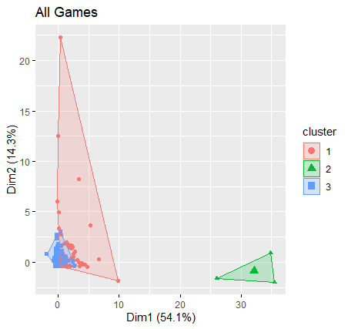

What’s K Means Clustering?
Achievements
VARIABLES
Gain
Peak
Playtime
Positive Reviews
Negative Reviews
Model
K
1
2
3
CLUSTERS

Slide 15

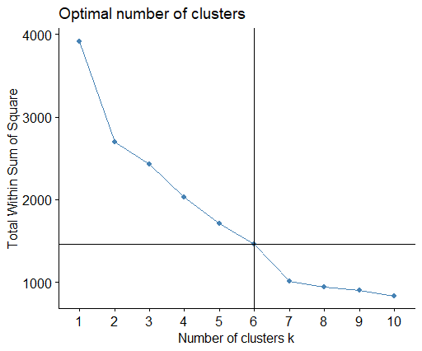
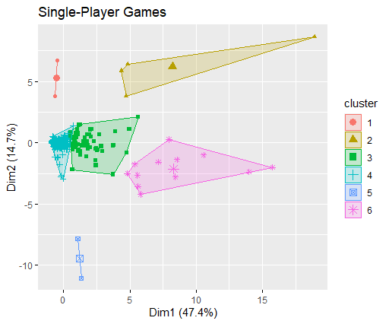
Single Players - 6 Clusters? Why 6?

Slide 16
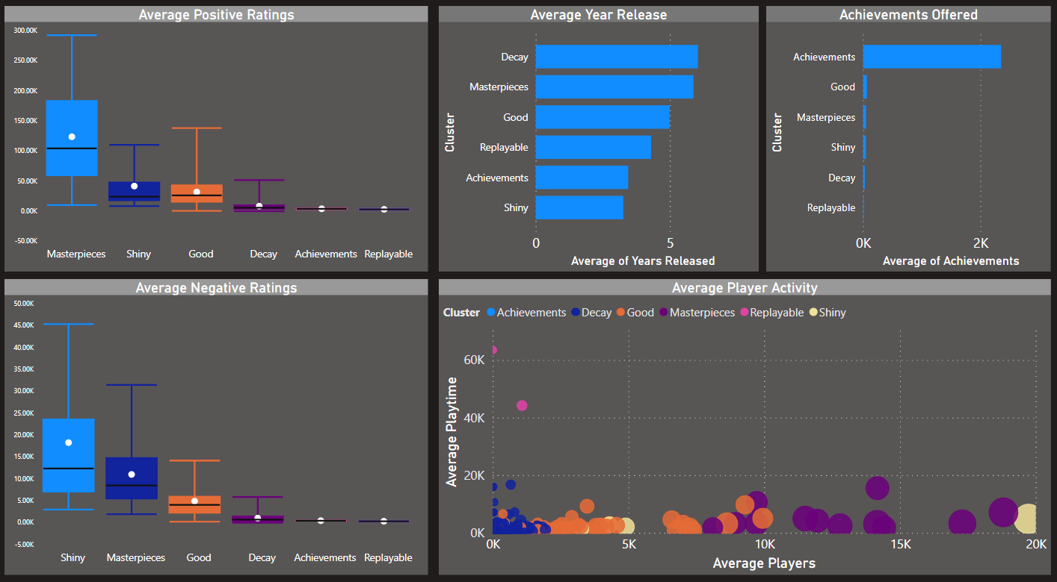
Single Players - What Are These “K”lusters All About?

Slide 17
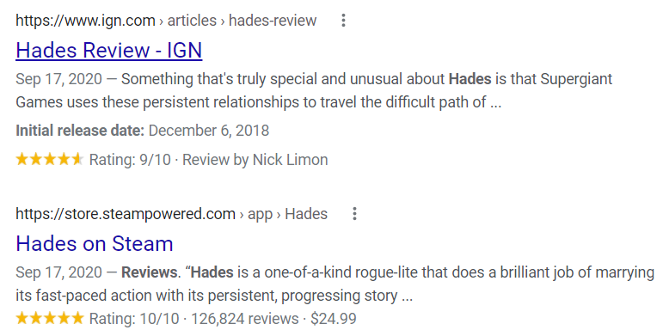

Our Model Works!
Cluster 6
War Thunder
Unturned
Borderlands 2
Black Desert Online
Hades
Wallpaper Engine
Euro Truck Simulator 2
The Elder Scrolls Online
The Witcher 3: Wild Hunt
The Elder Scrolls V: Skyrim Special Edition
The Elder Scrolls V: Skyrim
Cities: Skylines

Slide 18
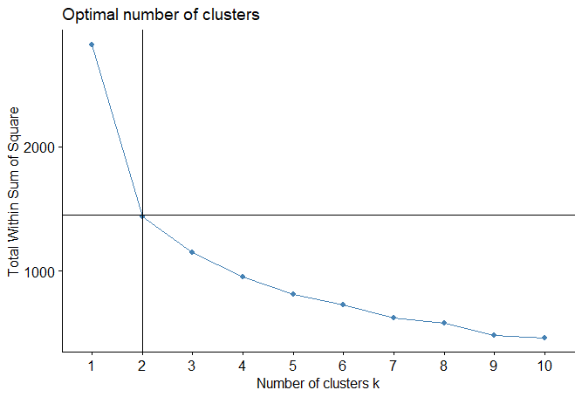
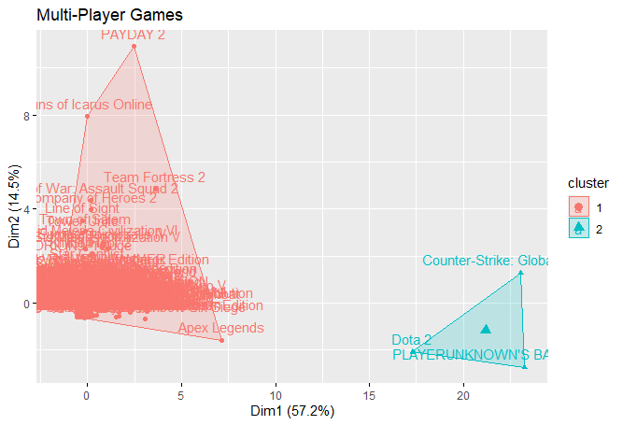
K-Means Clustering - Multi-Player Games

Slide 19
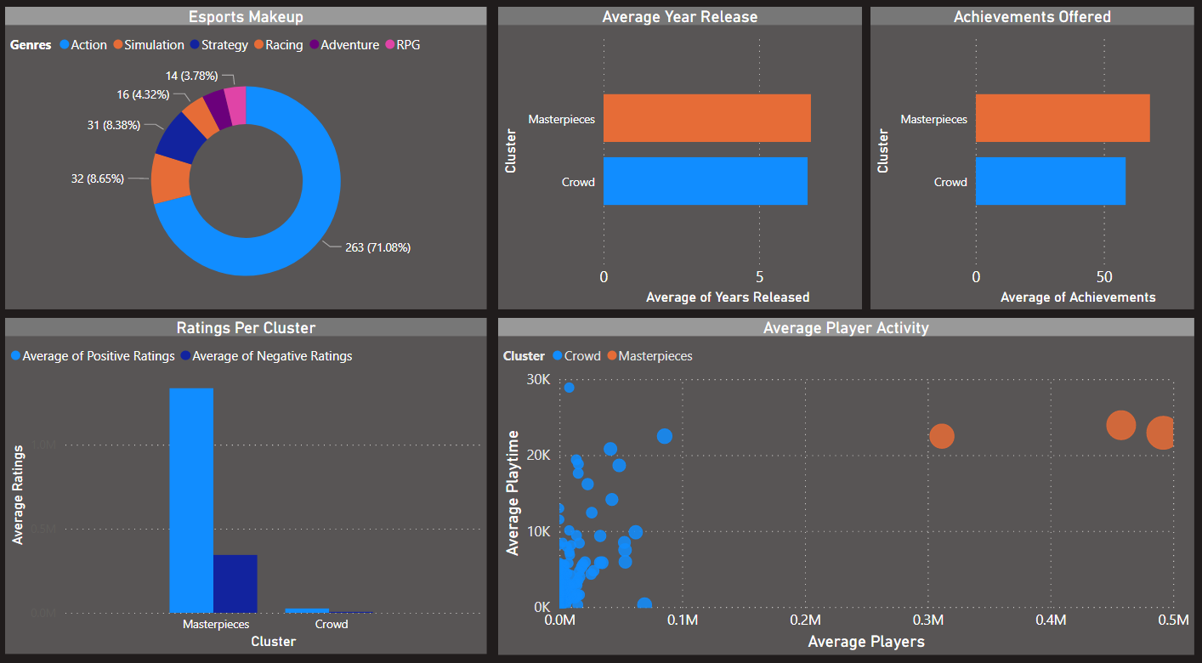
Multi Players - The World of Esports

Slide 20
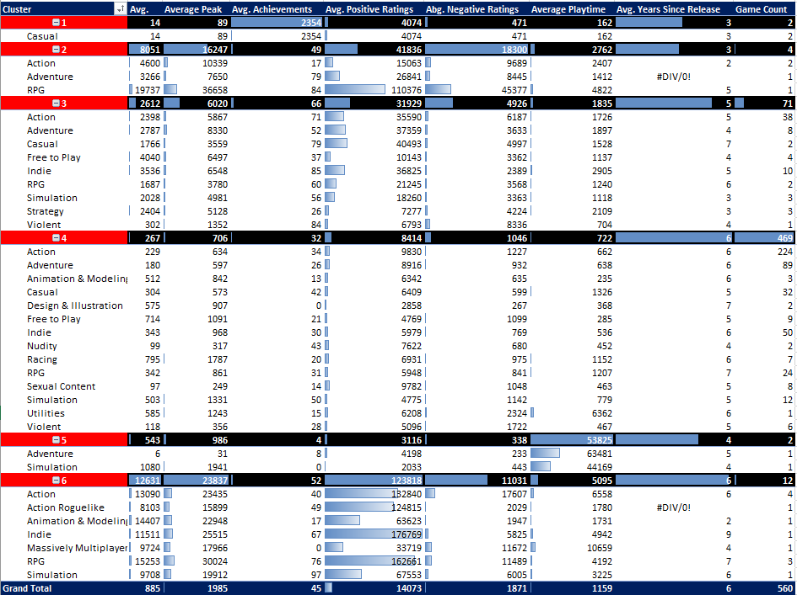
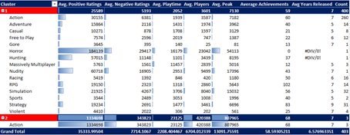
Go Deep!
Single Player Games
Multi Player Games

Slide 21
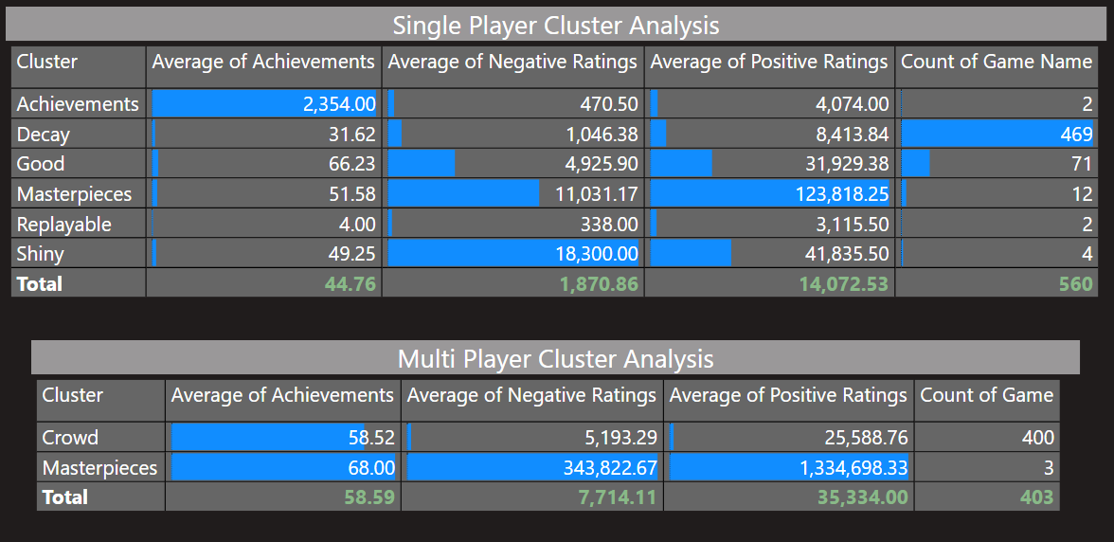
Custer Overview

Slide 22
Gaming 101
The framework to comprehend the industry
Gaming
Today
Gaming by the numbers
Popularity
The makeup of a popular game
Growth
How games grow in audience
Notes:
Objective: Introduce the next speaker… “Popular games have differences amongst each other, but do they grow different?. Andres will help us understand how games grow.”

Slide 23
Understanding growth is crucial for game survival
Game adoption and diffusion models
Methods and Tools
Uncertain returns
Data file included data scraped from Steam (a game streaming platform) and sourced from Kaggle
The study reviewed 767 distinct games over their first 60 months (5 years) of operation.
Variables studied included monthly average users and size categorization on XS, S, M, L, XL.
The monthly average users variable was normalized.
Our team used the k-means classification method to group growth profiles for all 767 distinct games.
Investments in sales and marketing account for over 20% of Operational costs for game developers and publishers.
The largest operational cost is game development and multiproduct game studios need to decide which games to invest way before they understand their potential return.
Key Growth Questions
Is there a common growth profile?
Do large games grow faster than smaller ones? (i.e. do scale matter?
Do some games recover from lack of grow?
Notes:
Thank you Pablo.
Growth is very important for Game developers and publishers.
Growth is the engine of profitability and engagement within each game and
Drives large investment decisions accounting for more than 20% of costs
Our objective has been to find if games share a growth profile. A path when they grow.
How grow differs by size and whether slow growth is recoverable.
We analysed 767 games through their first 60 months using data from Steam.
Our study used R as the analytical tool and we used the k-means clustering algorithm.
There is no “average growth curve”

Slide 24
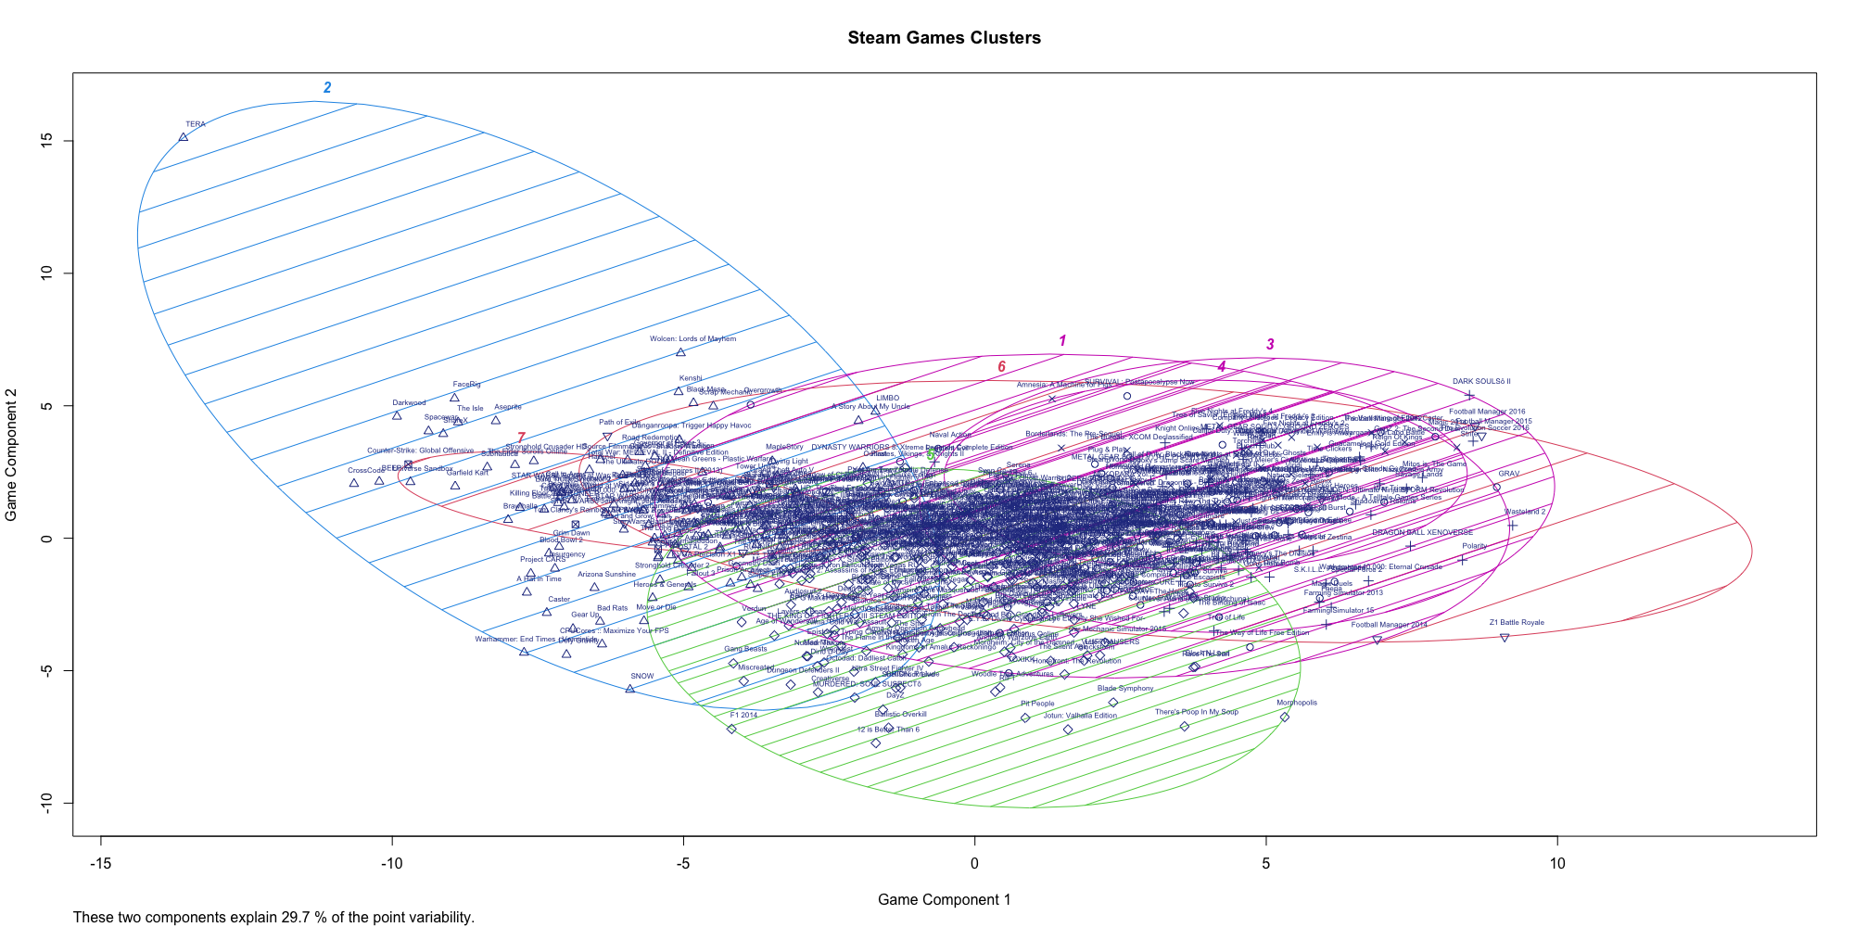
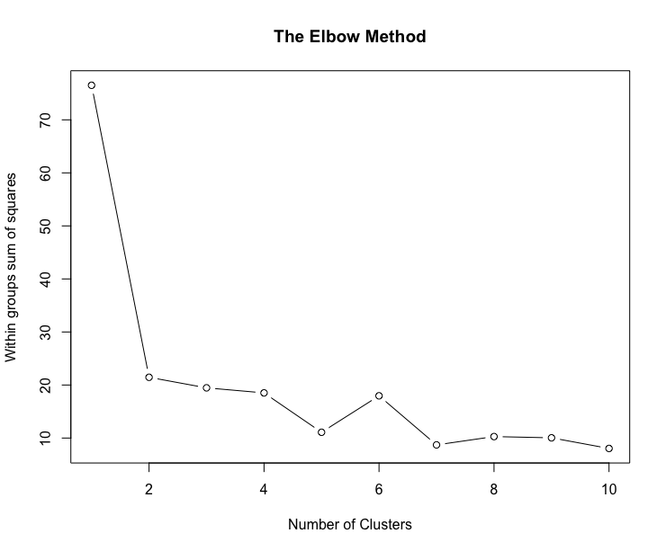
There are seven distincts groups of games
Notes:
Our algorithm deployment gave us seven distinct groups of games and each one provided us with…

Slide 25
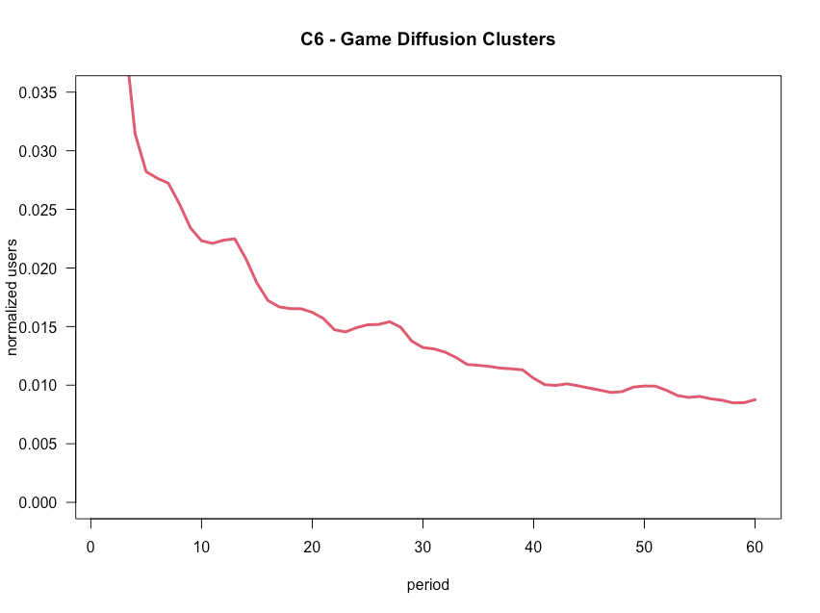




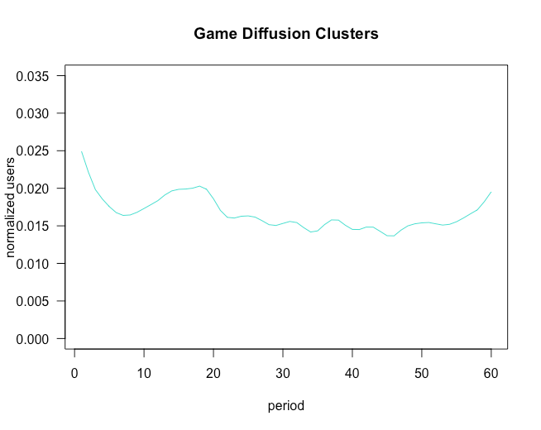




There are seven distincts groups of games

Slide 26
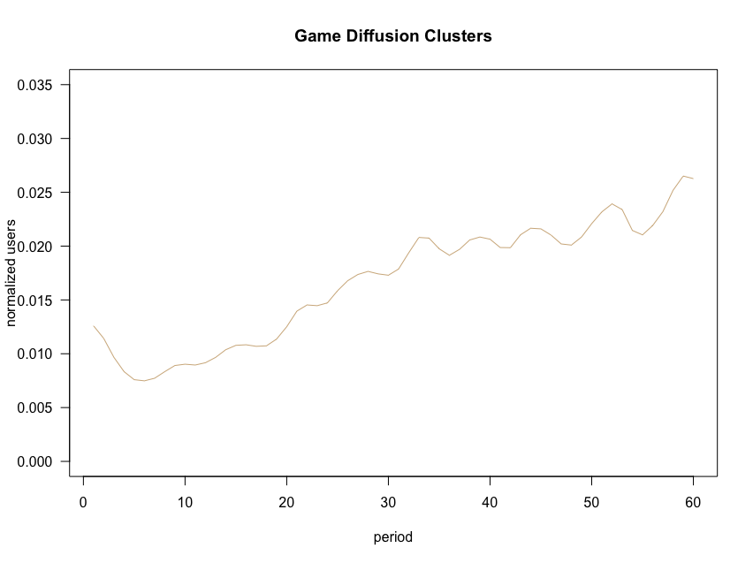





There are seven distincts groups of games

Slide 27
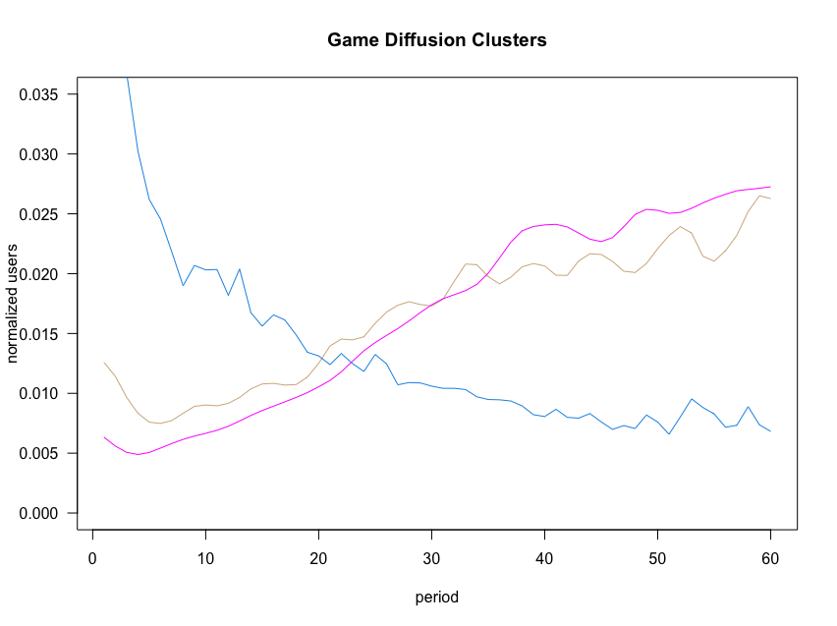
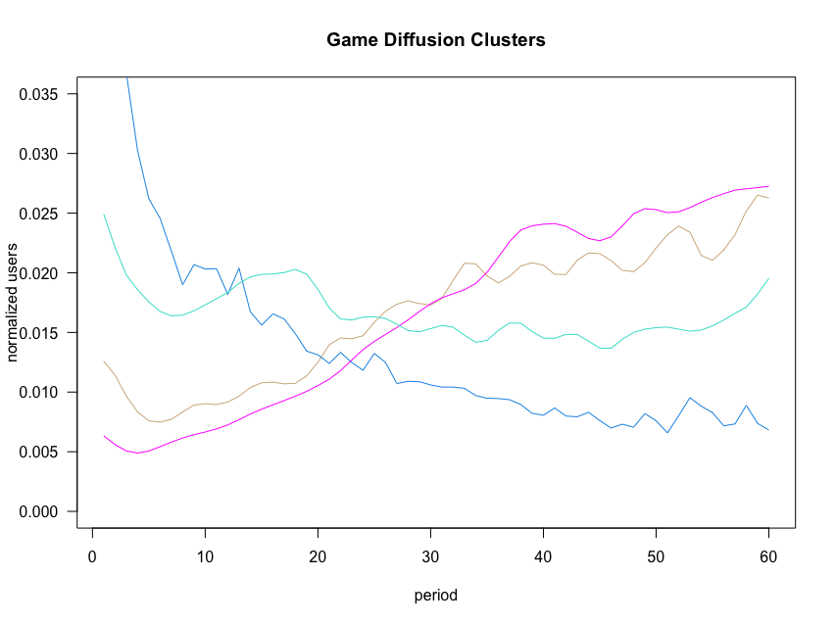
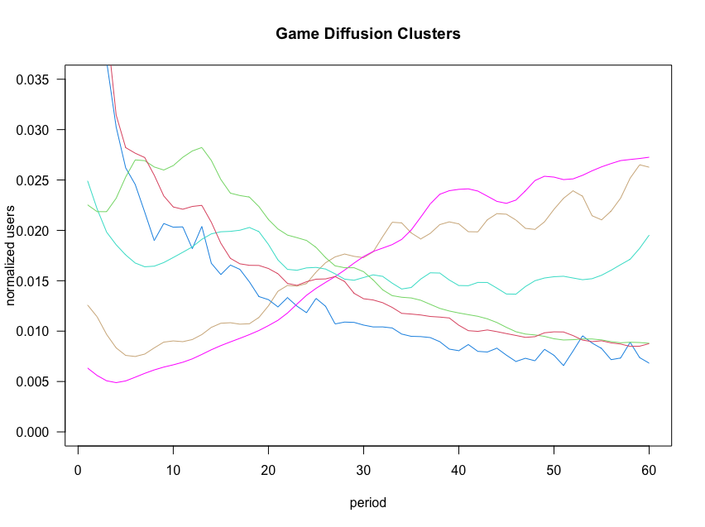
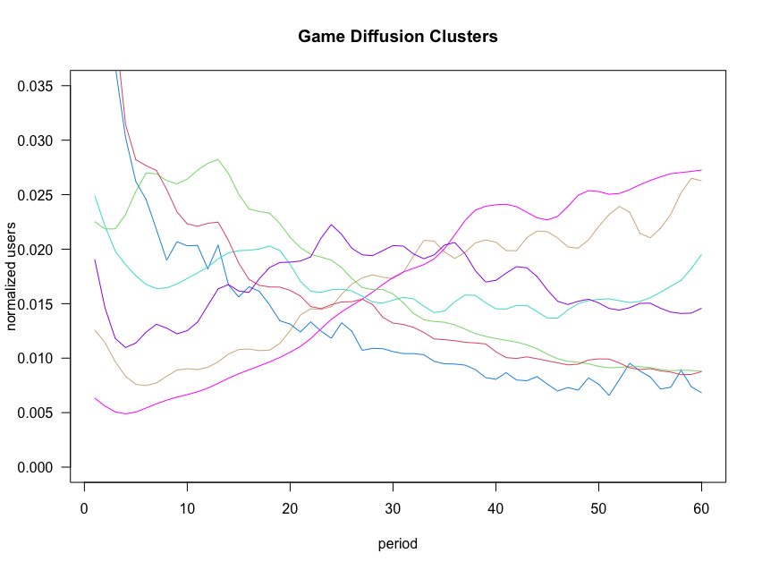
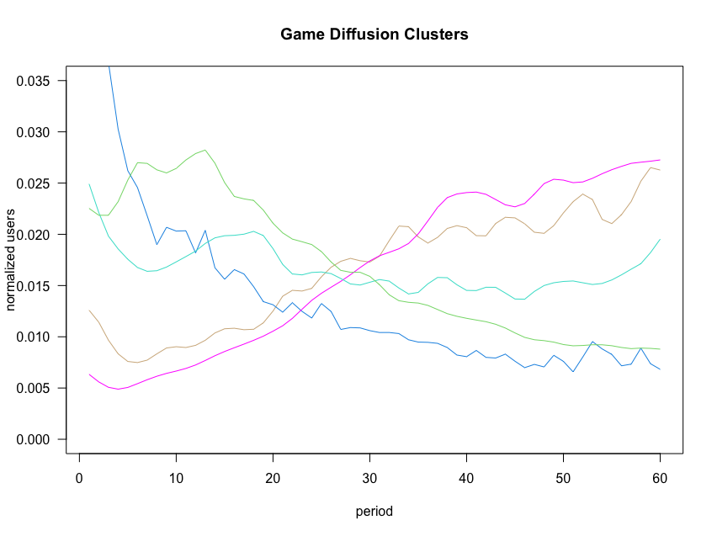
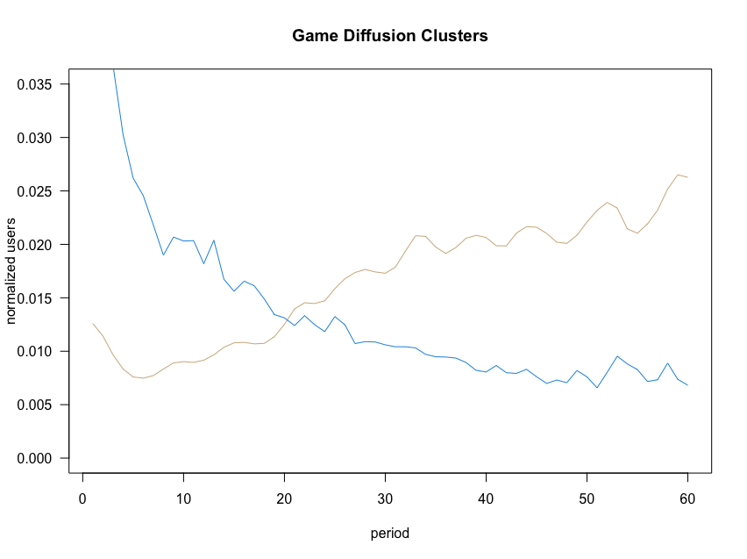
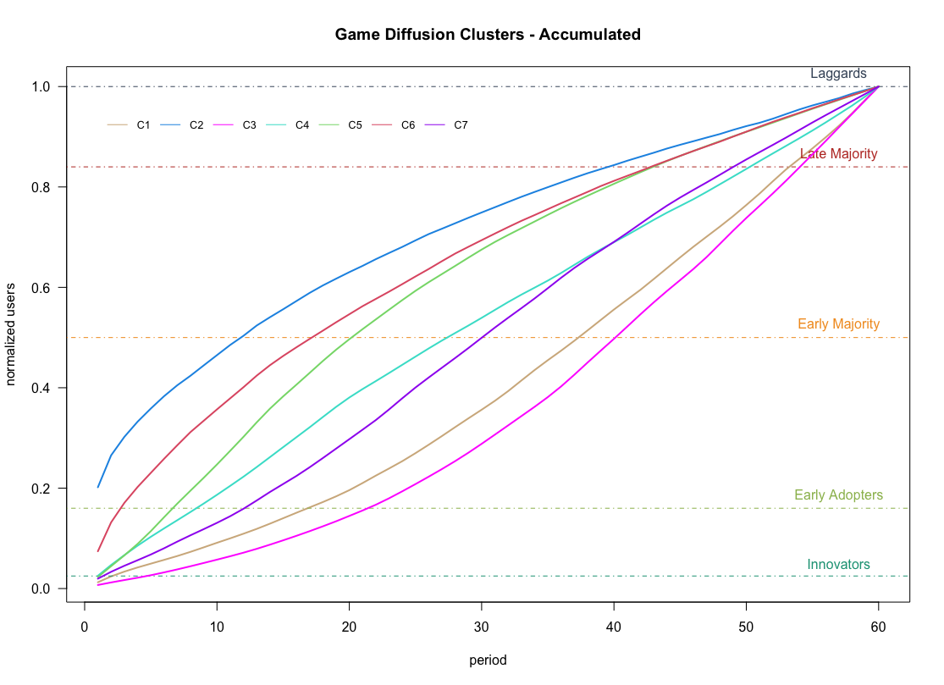
There are 7 growth profiles that illustrate diffusion
Notes:
...a distinct growth profile.
Each line outlining the normalized grow path for each group of games
As you can see for some of them higher growth takes places early on. (click)
While for others, it happened later in their lifecycle. (click)

Slide 28
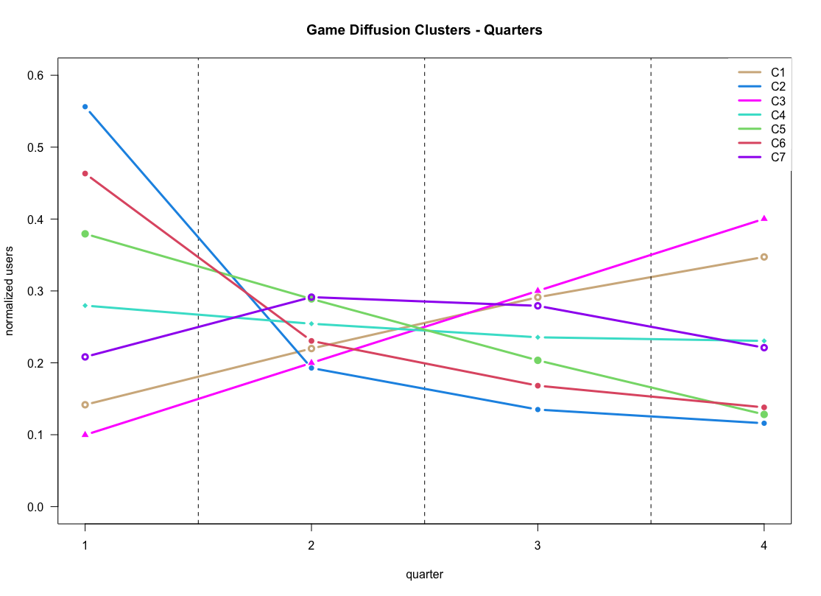
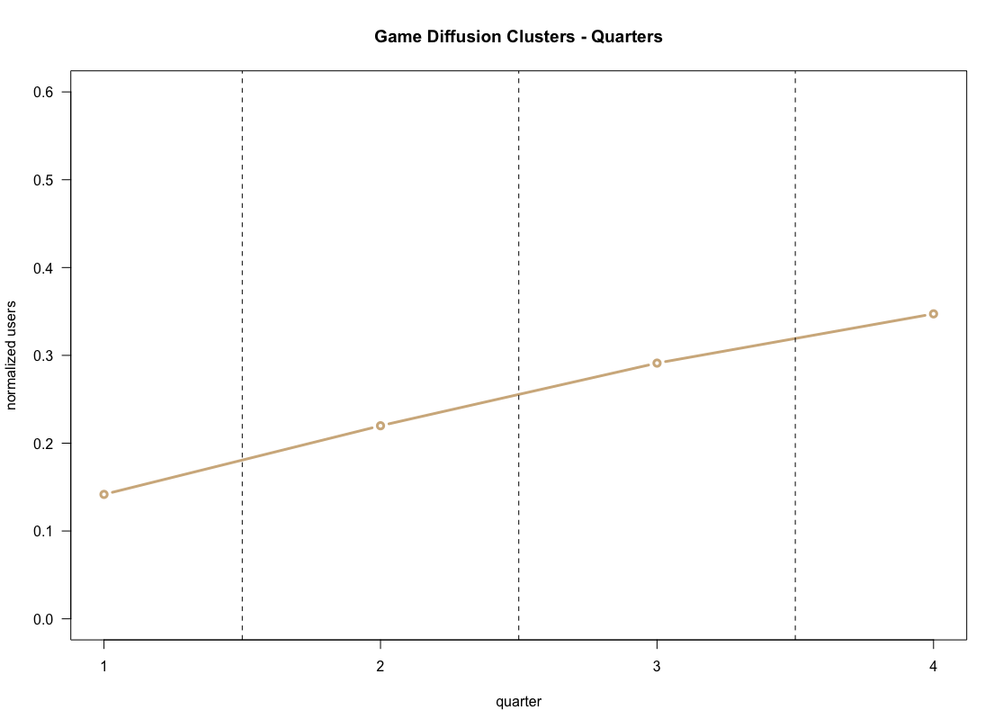

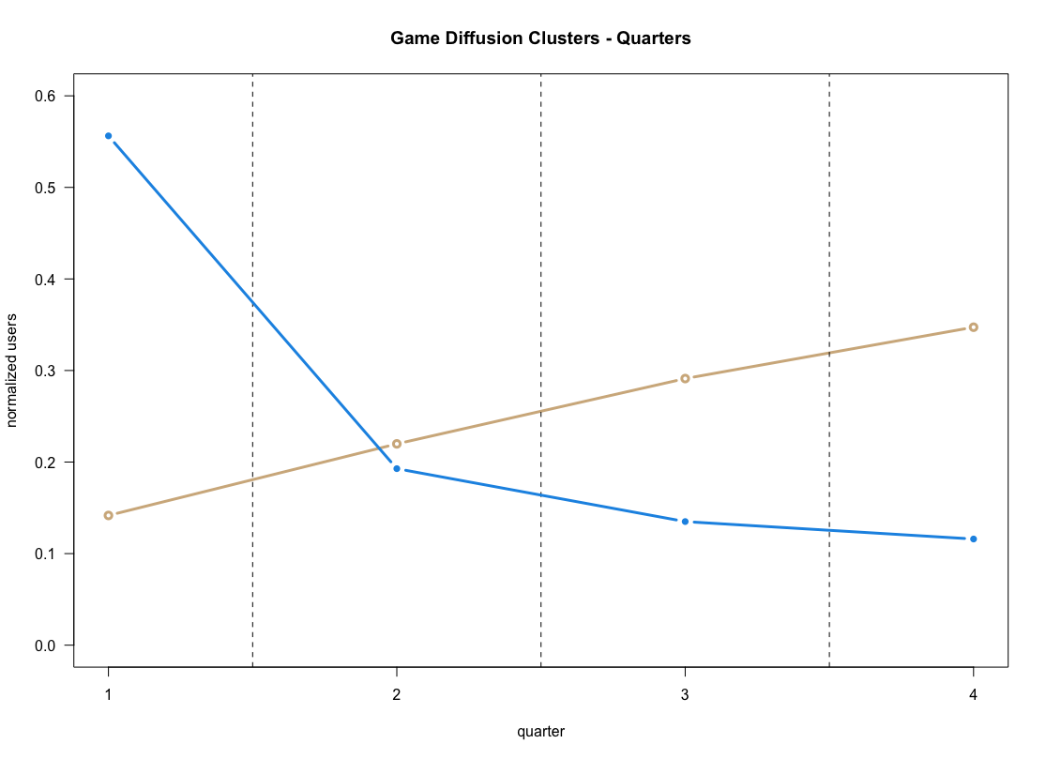
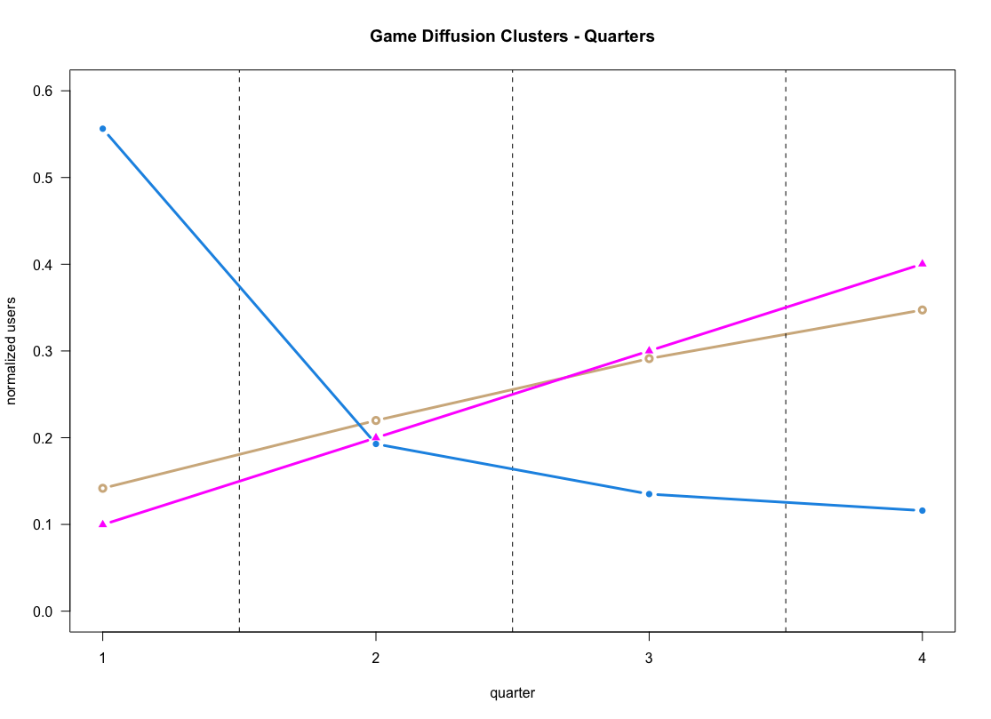
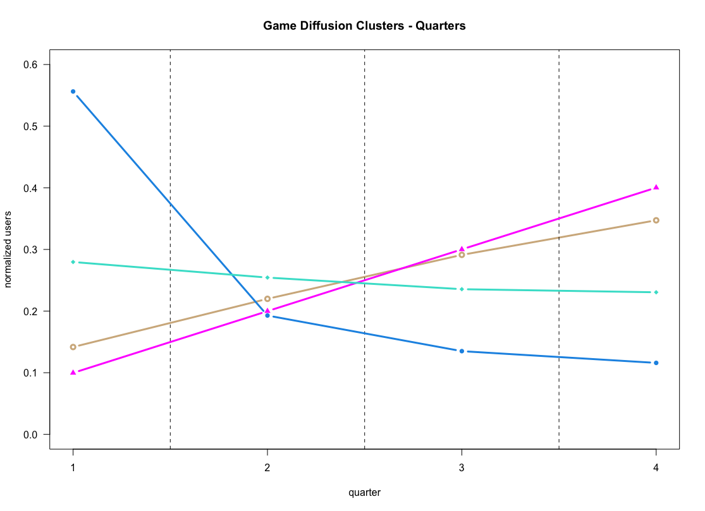
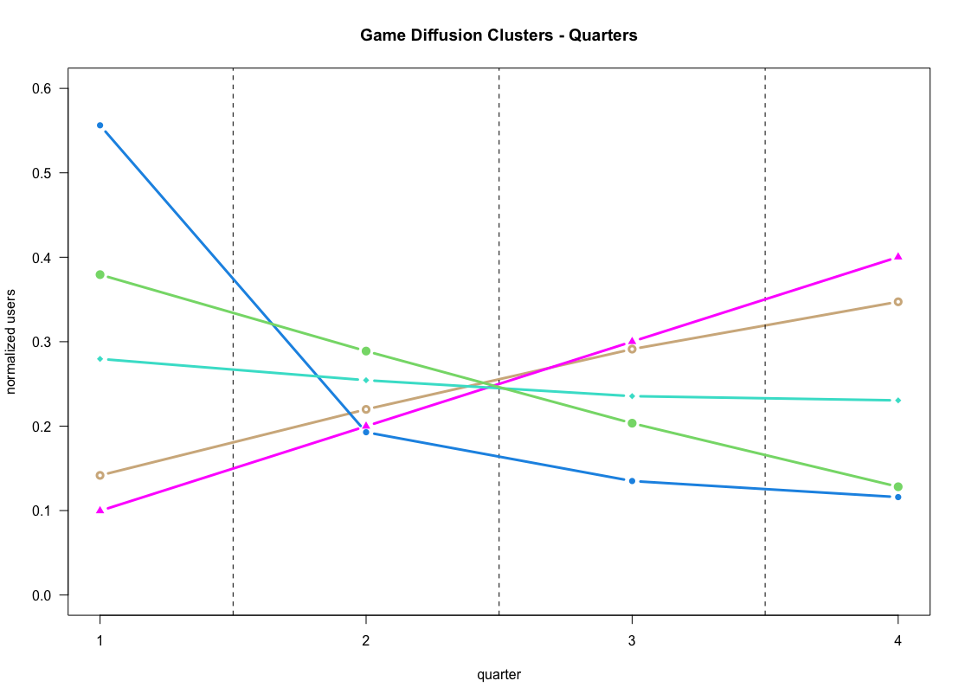
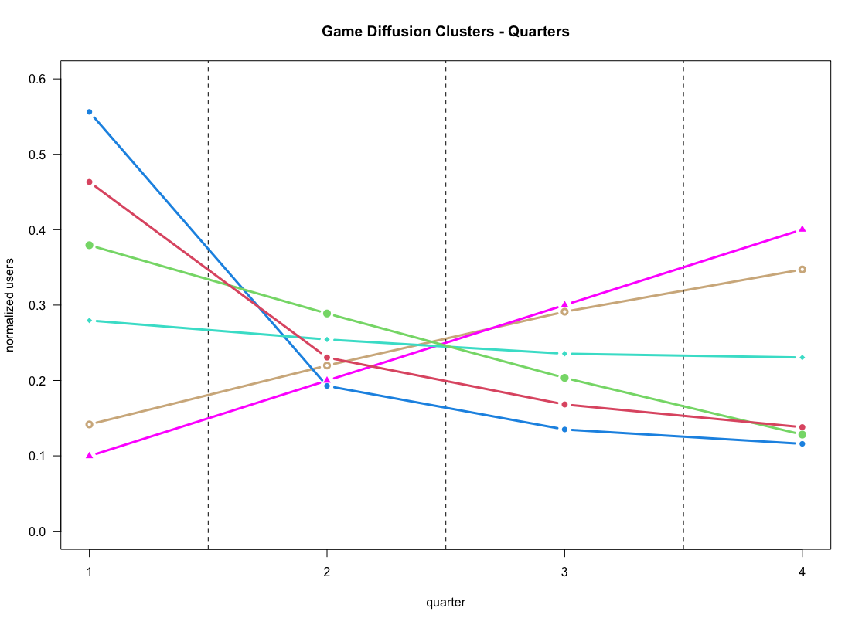
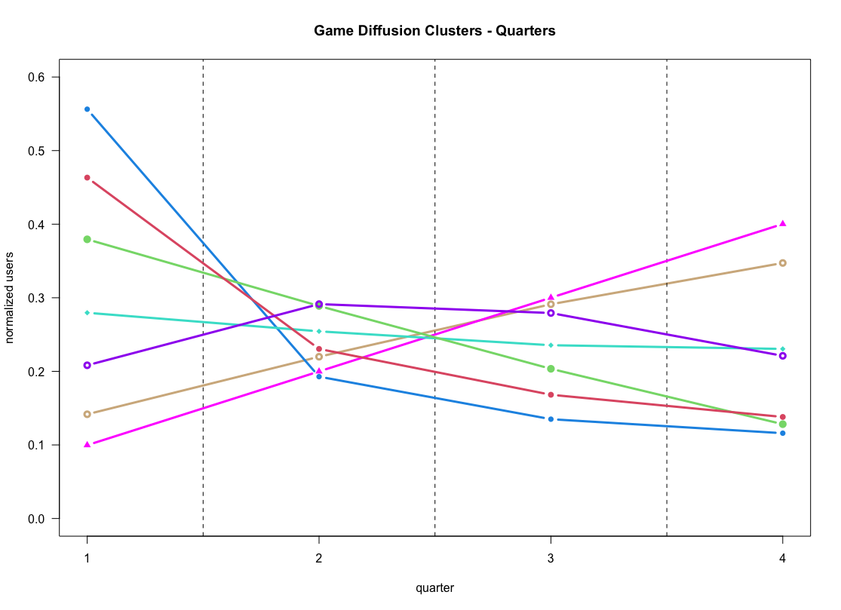
To simplify we aggregated growth quarterly
Notes:
To simplify the study we broke down the 60 periods in quarters
And we were better able to notice that the main differences in growth
Across the different groups take place in the first quarter
Three clusters gather their user base early on but end up with slower growth at the end. (click) (click)
A quarter represents a little over one year.
Been a hit or been a staple is very different.
Whether a game is playable in the long term or provides a short burst of fun do matter and each can have different monetization mechanics.
Since Steam is pay to play what matters is to monetize early on since novelty might wash away with time.
So far, we have discussed growth distribution…
For understanding velocity we turned to… (click)

Slide 29
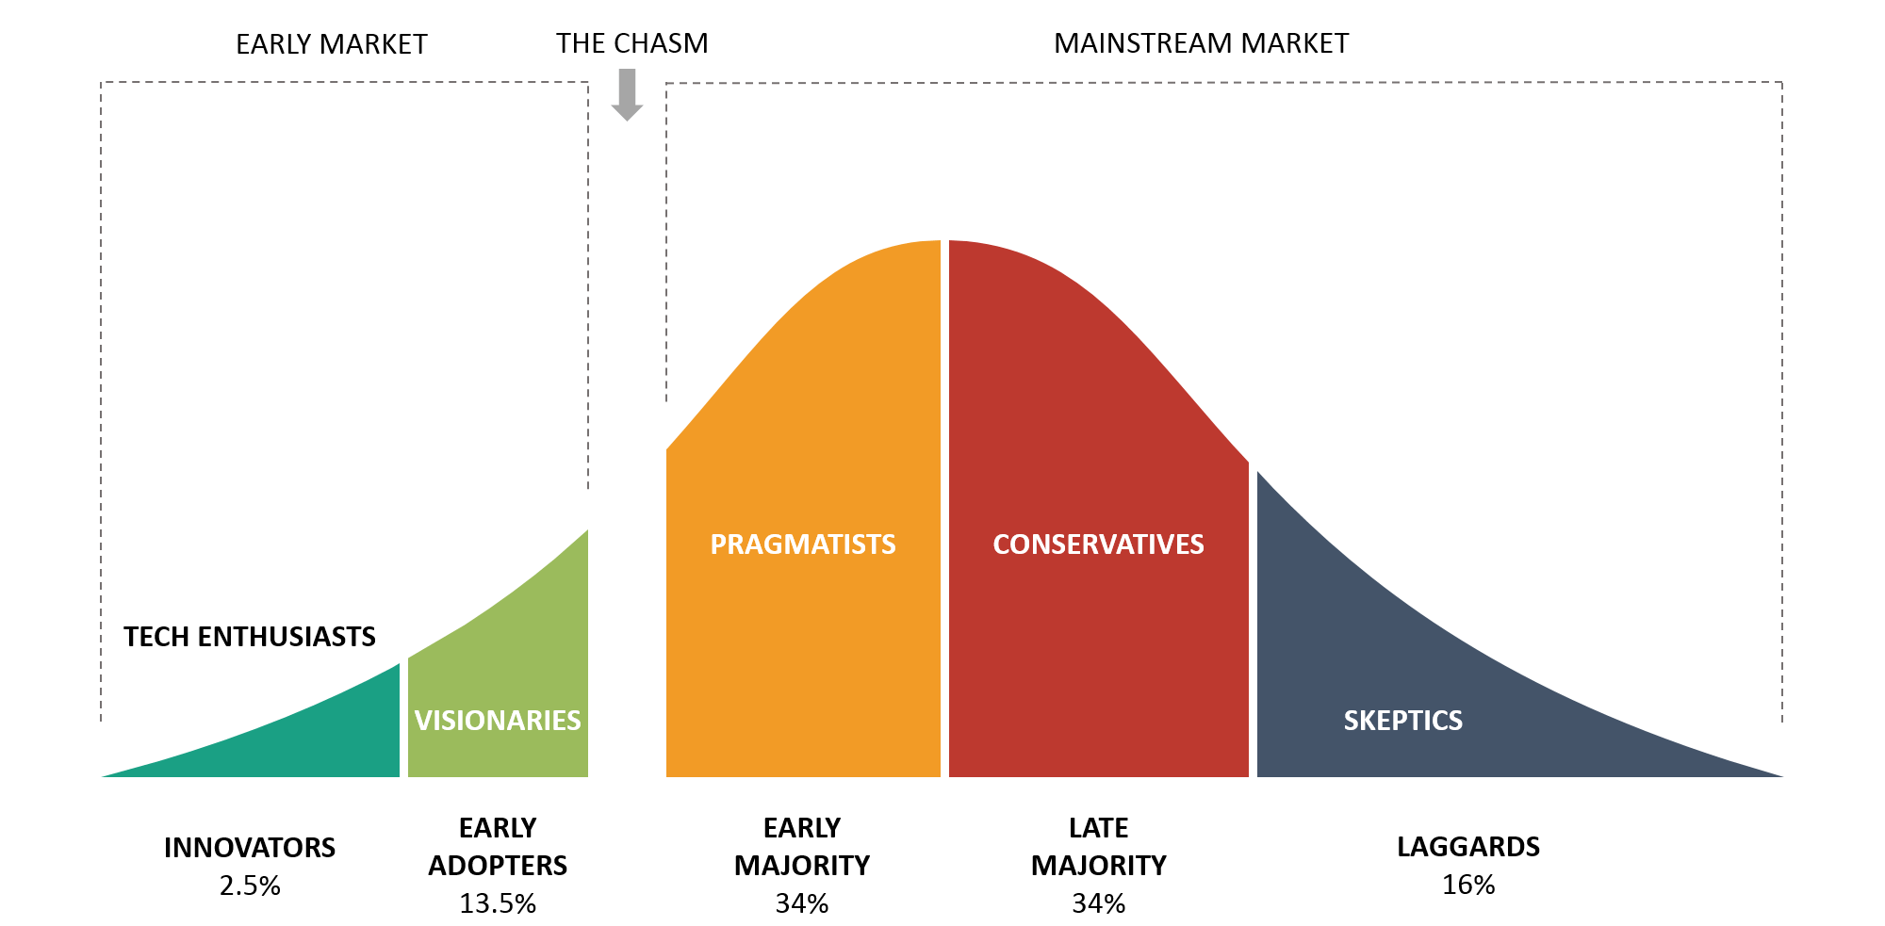

Moore’s tech adoption curve is a useful framework
Source: “Crossing the Chasm”, Moore (1991)
Notes:
Geoffrey Moore with his tech adoption curve
Which tells us how people adopt technology
First the innovators come in accounting for 2.5%
Then early adopters who are about 13.5%
If the technology (or in our case the game) is able to cross the chasm.
The early, late majorities adopt it and the laggards at the end.
We find this framework useful to analyze our games.
To do so…

Slide 30
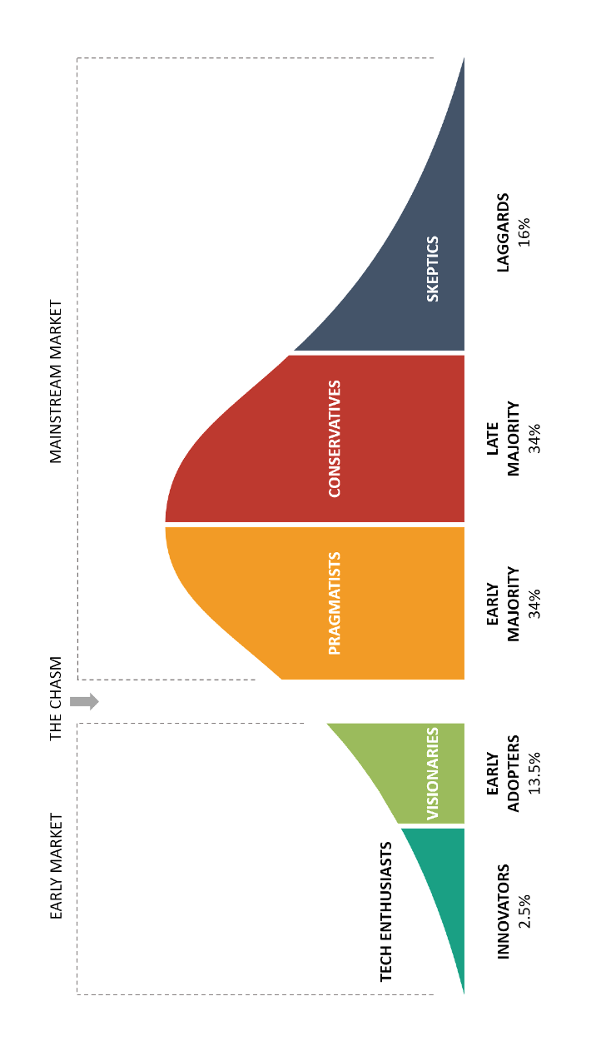
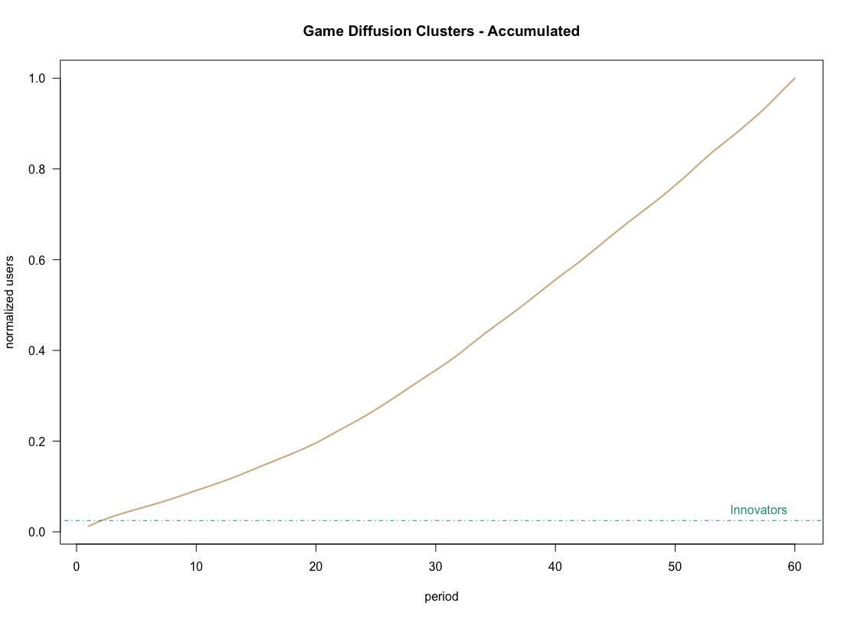
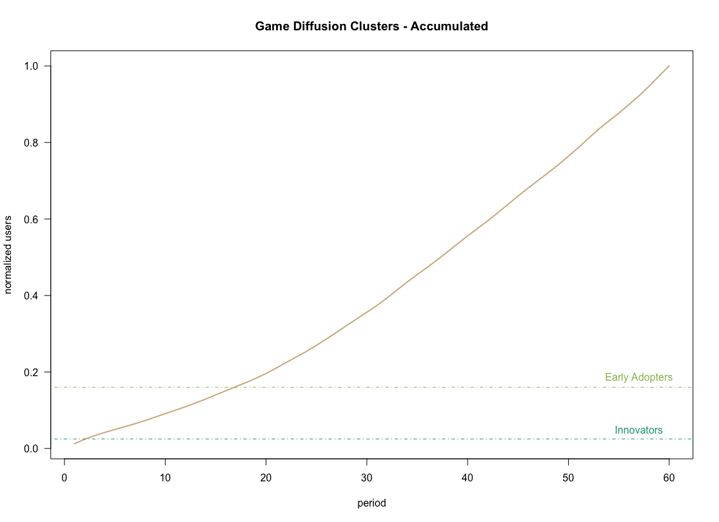
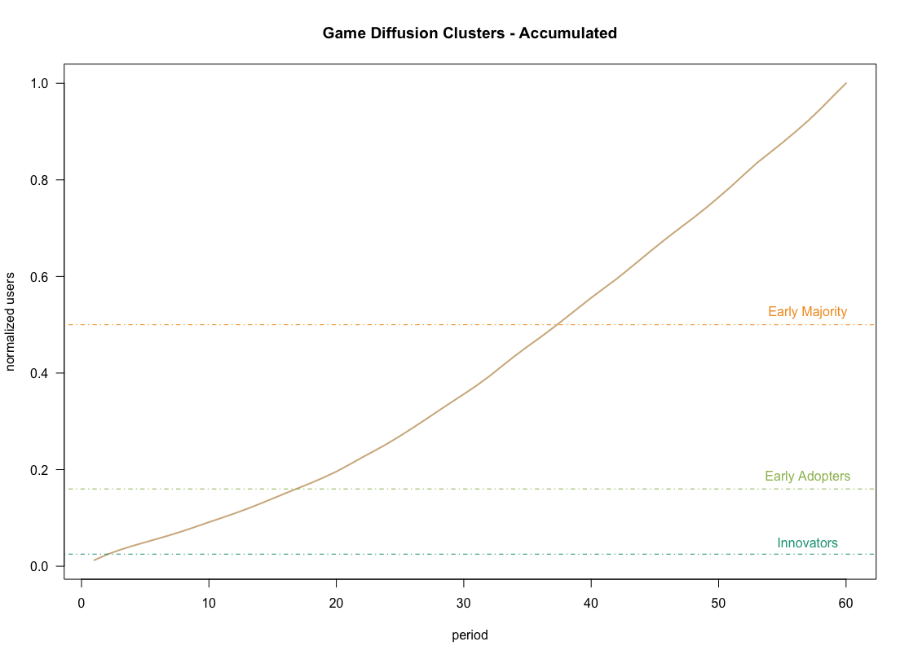
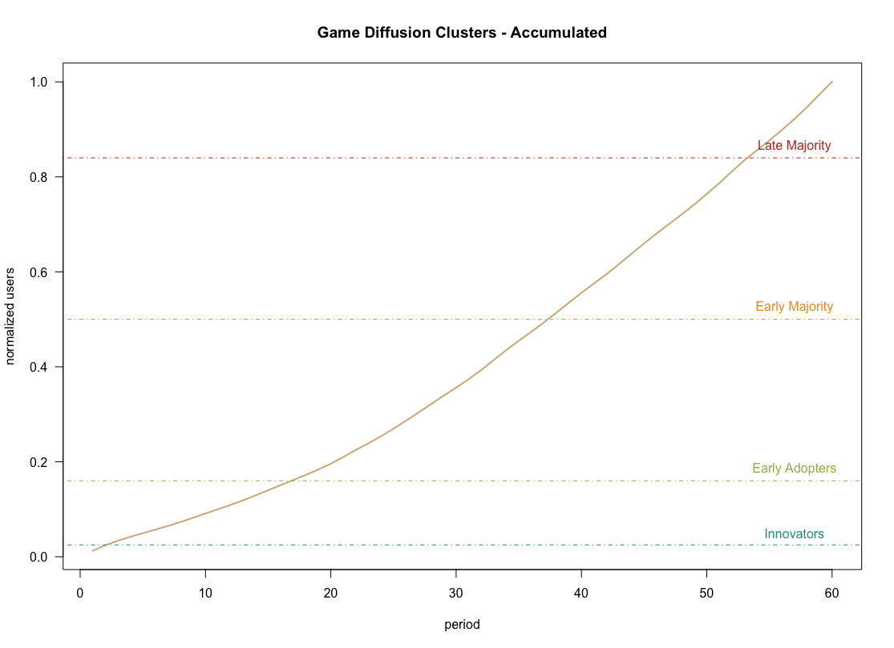
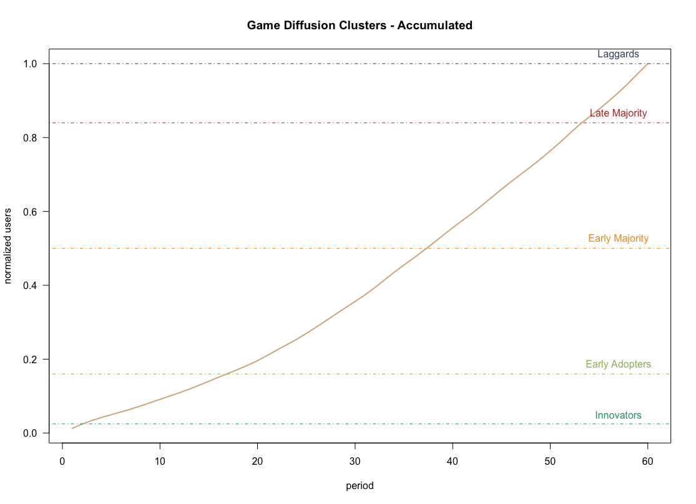
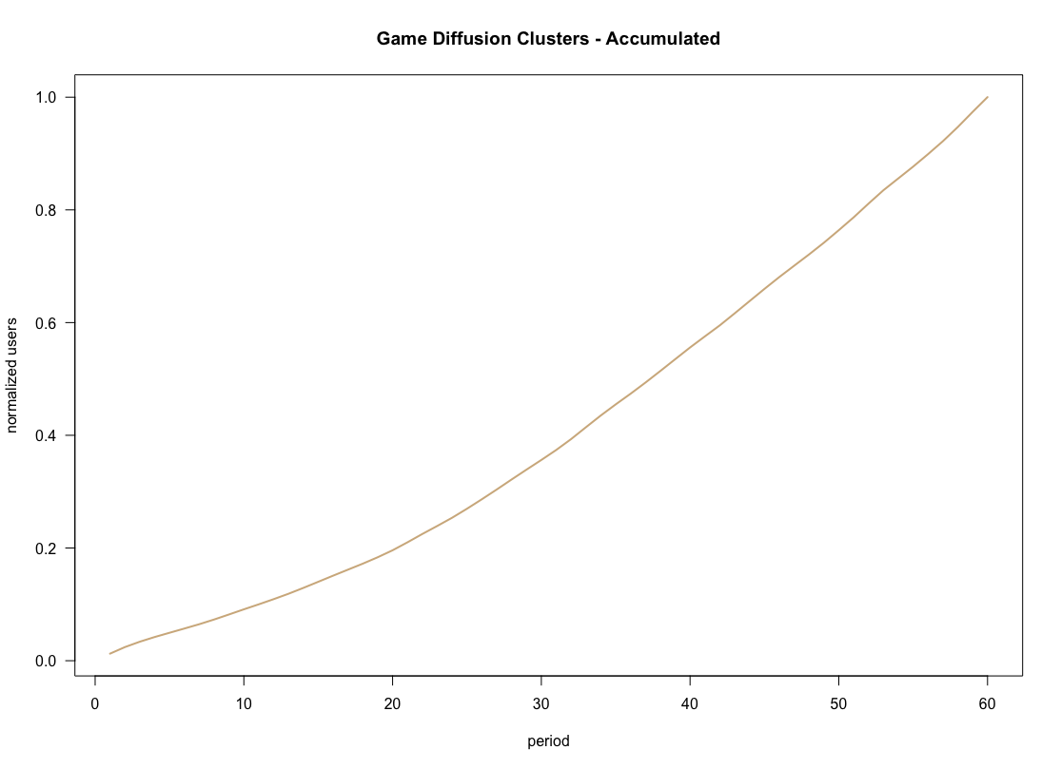
Crossing the Chasm
X
X
X
X
X
Notes:
Now we can more easily distinguish points for which each of the games (click)
Crossed the adoption chasm, with some of them as early as three months
While other in the cluster 3 coming in after month 22 (almost two years later!!!

Slide 31
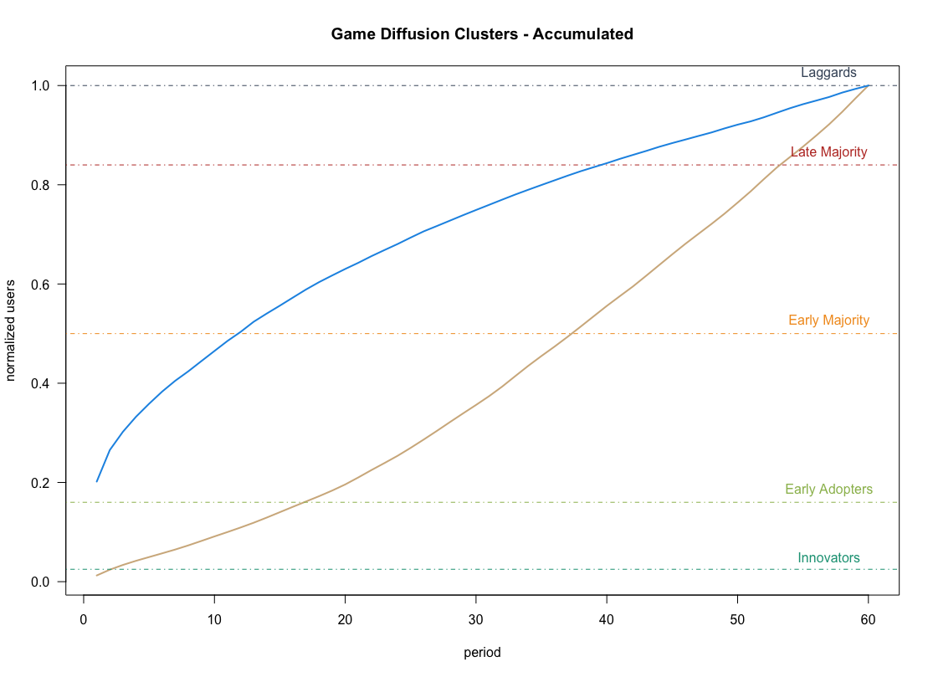
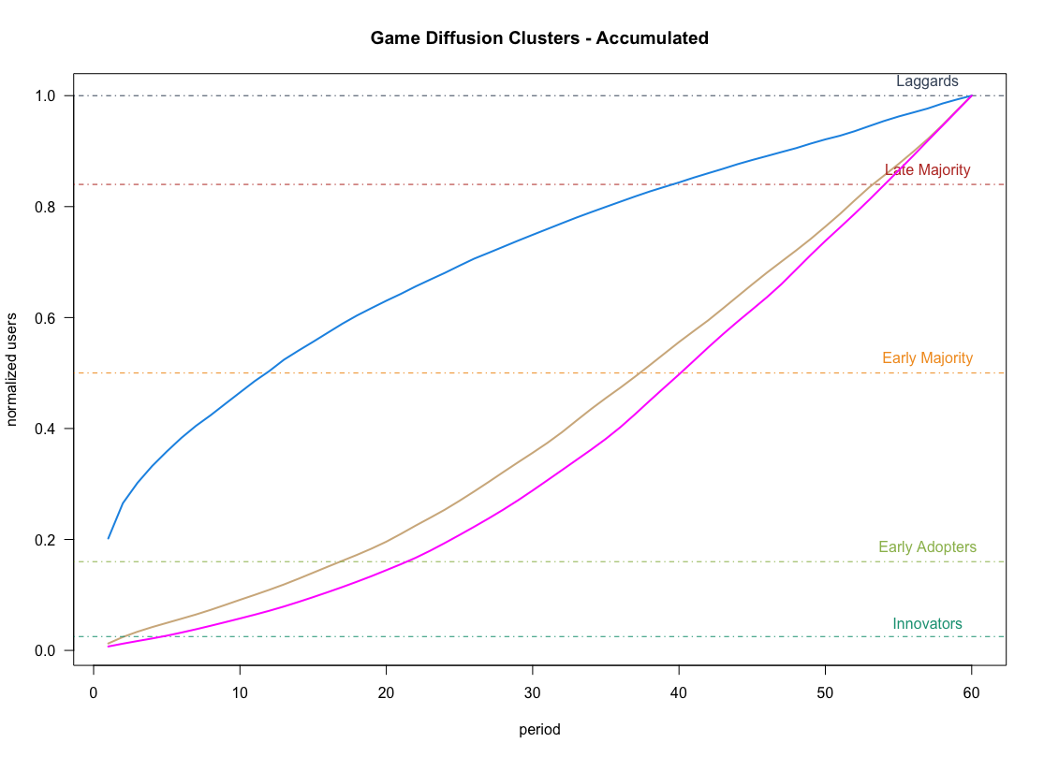




Crossing the Chasm
Chasm Crossing
C2: 2
C6: 4
C5: 6
C4: 8
C7: 12
C1: 17
C3: 22
Convergence
Points
C5-C6: 44
C7-C4: 38
X
X
X
X
X
X
X
Notes:
Now we can more easily distinguish points for which each of the games (click)
Crossed the adoption chasm, with some of them as early as three months
While other in the cluster 3 coming in after month 22 (almost two years later!!!

Slide 32
Key learnings and potential areas for further research
Gaming is no “game”...
1
Visual relationship between Twitch, eSports, and gaming
2
Single and multiplayer games differ in ways that developers and publishers need to take into account
3
Game developers need to match their game adoption curve early after launch and invest to realize their growth pattern potential
With more data…
Earnings and monetization could add another parameter for success
Diversity outside of Steam could provide insight on top games with other proprietary gaming platforms. (Battle.net, Riot Games)
Aggregate other platforms to provide insights into how each platform can facilitate better growth and game diffusion.
Notes:
Overall it was a fascinating experience and we enjoyed
Connecting the dots in the relationships between Twitch, eSports and Gaming overall
Finding that single and multiplayer games are inherently different in their make up, and
Game developers should match their growth trajectories as soon as possible in order to realize their games growth potentials.
Most certainly, with more data and time and access to premium reports we could look into monetization per game as part of the growth potential
Looking into other platforms for information and better understanding growth diffusion.
We hope you enjoyed our analysis as much as we did and we look forward to hearing the questions you might have.

